Slide 1
The Human Experience.
The human experience
10th grade
Language Arts Subject for High School:
Here is where your presentation begins

Slide 2
01.
Introduction
02.
Character & culture
03.
Literary analysis
04.
Activities
Table of contents
The human experience
10th grade
You can describe the section here
You can describe the section here
You can describe the section here
You can describe the section here

Slide 3

Introduction
The human experience
10th grade
You can give a brief description of the topic you want to talk about here. For example, if you want to talk about Mercury, you can say that it’s the smallest planet

Slide 4
01.
Introduction
The human experience
10th grade
You can enter a subtitle here if you need it

Slide 5
Important facts
1,925
1,954
Venus is the second planet from the Sun and has very high temperatures
Mars is full of iron oxide dust, which gives the planet its reddish cast

Slide 6

More about the human experience
Do you know what can help you to make your point clear?
Lists like this one:
They’re simple
You can organize your ideas clearly
You’ll never forget to buy milk!
And the most important thing: the audience will certainly not miss the meaning of your presentation

Slide 7
Historic context in analysis & interpretation
The Sun is the star at the center of the Solar System
Mercury is the smallest planet in the Solar System
16th century
19th century
14th century
18th century
Earth is the planet that harbors life in the Solar System
Mars is actually a cold place full of iron oxide dust

Slide 8
Important literary cradles
Europe
Neptune is the farthest planet from the Sun and the fourth-largest
Asia
Venus has a beautiful name and is the second planet from the Sun

Slide 9

128,871
The human experience
10th grade
Big numbers catch your audience’s attention

Slide 10
Critical approaches to literary analysis
Jupiter
Mercury
Saturn
Venus
Neptune
Mars
Jupiter is a gas giant and the biggest planet in the Solar System
Mercury is the closest planet to the Sun and the smallest one
It was named after the Roman god of wealth and agriculture
Venus has a beautiful name and is the second planet from the Sun
It's the fourth-largest planet by diameter in the Solar System
It's full of iron oxide dust, which gives the planet its reddish cast

Slide 11
02.
Character & culture
The human experience
10th grade
You can enter a subtitle here if you need it

Slide 12

Character & culture
Character
Culture
Mercury is the closest planet to the Sun and the smallest one in the System—it’s only a bit larger than the Moon
Venus has a beautiful name and is the second planet from the Sun. It’s hot and has a poisonous atmosphere

Slide 13
Did you know this variety of important historical facts?
+25%
1,350
158,171
71%
Mercury is quite a small planet
Earth is where we all live on
Mars is actually a cold place
Pluto is considered a dwarf planet

Slide 14

Awesome words
The human experience
10th grade

Slide 15
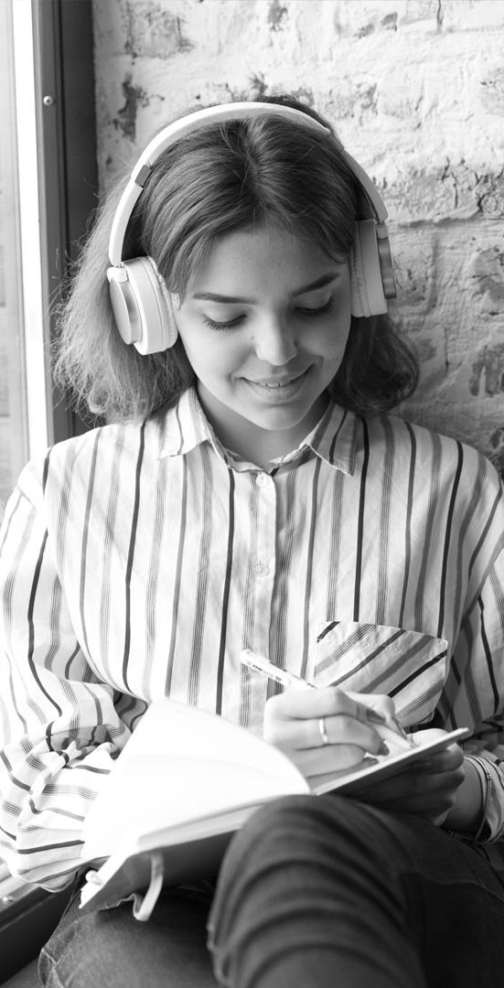
Writing a literary analysis
Jupiter
Mars
Venus
Saturn
Jupiter is a gas giant and the biggest planet in the Solar System
It's full of iron oxide dust, which gives the planet its reddish cast
Venus is terribly hot and its atmosphere is extremely poisonous
It was named after the Roman god of wealth and agriculture

Slide 16
Whoa!
The human experience
10th grade
This can be the part of the presentation where you share an interesting fact with your students

Slide 17

Literary analysis of ancient texts
Mars
Mercury
Venus
Despite being red, Mars is a cold place. It’s full of iron oxide dust
It’s the closest planet to the Sun and the smallest in the Solar System
Venus has a beautiful name and is the second planet from the Sun

Slide 18
How to write a comparative analysis
01.
02.
Assumption
Identify
Mercury is the closest planet to the Sun
Ceres is located in the main asteroid belt
03.
04.
Analysis
Development
Saturn is a gas giant and has several rings
Jupiter is the biggest planet of them all

Slide 19
The importance of the analysis
Assumption
Differences
Similarities
Mars is actually a cold place
Earth is where we all live on
Ceres is in the asteroid belt
Neptune is far away from us

Slide 20

The human experience
10th grade
A word is worth a thousand words

Slide 21
Analyzing settings
 | Content | Context | Message
Character 1 | Pluto is now a dwarf planet | Jupiter is the biggest planet | Mercury is the smallest planet
Character 2 | Neptune is far away from us | The Moon is a natural satellite | Earth is where we all live on
Character 3 | Saturn has several rings | Ceres is in the asteroid belt | Mars is actually a cold place

Slide 22
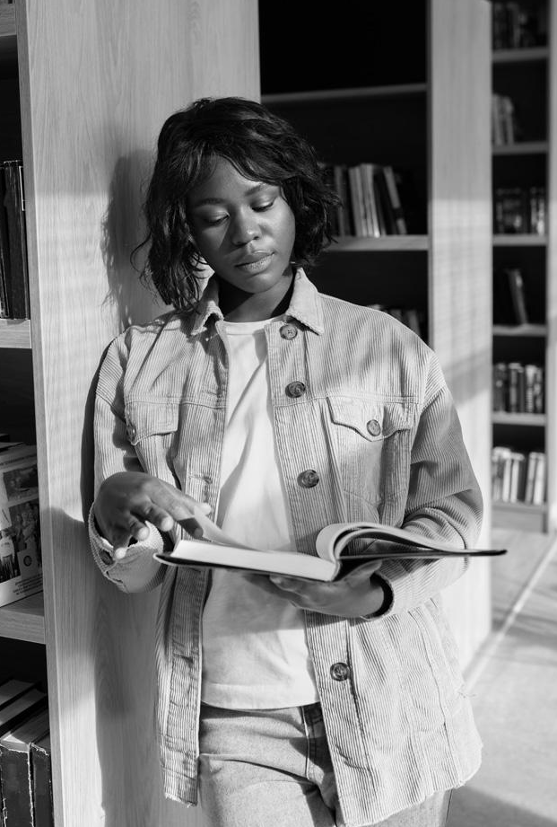
—Someone Famous
The human experience
10th grade
“This is a quote, words full of wisdom that someone important said and can make the reader get inspired.”

Slide 23
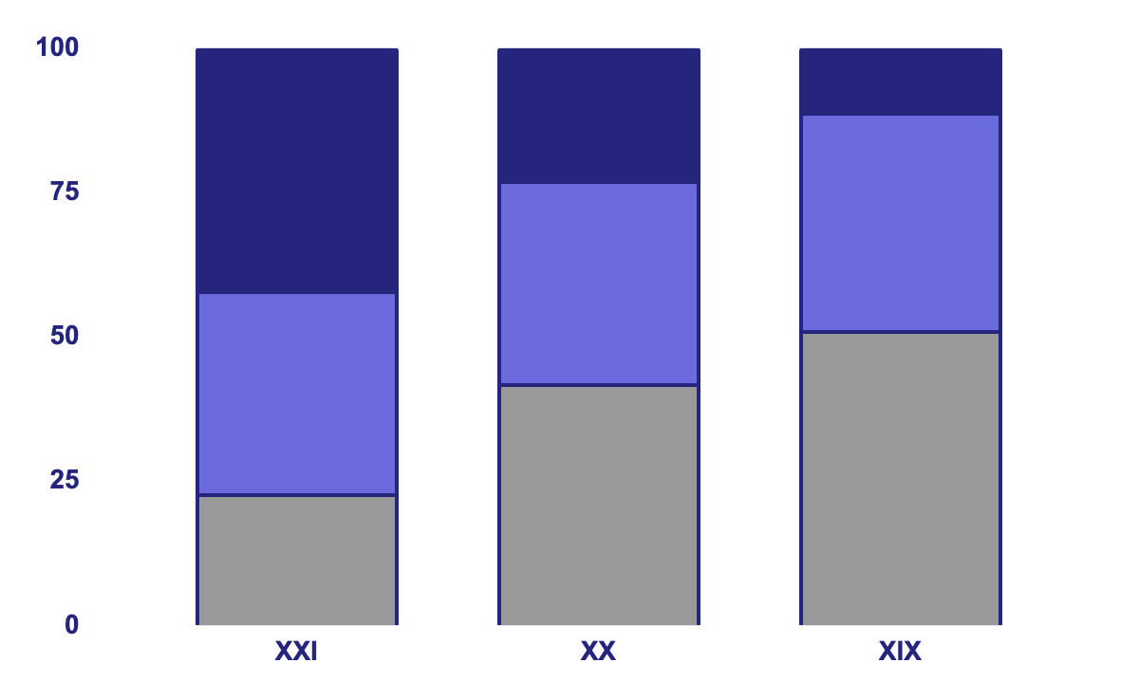
Evolution of literary genres
Narrative
Jupiter is a gas giant and the biggest planet of them all
Drama
Mars is full of iron oxide dust, giving the planet its reddish cast
Lyrical
Mercury is the closest planet to the Sun and the smallest one

Slide 24
10th centuries
1,880
1,455
The human experience
10th grade
Mercury is the closest planet to the Sun
Mars is actually a cold place
Ceres is in the main asteroid belt

Slide 25
Match the description to the genre
A text about the solution of a crime
Biography
The true story of someone’s real life
Newspaper
A story with fictional characters and events
Fiction
A collection of articles and events
Thriller

Slide 26

A picture always reinforces the concept
The human experience
10th grade
Images reveal large amounts of data, so remember: use an image instead of a long text. Your audience will appreciate it

Slide 27
Fiction or nonfiction: genres of literature
Fiction | Nonfiction
Fantasy
Newspaper
Thriller
Biography
Mystery
Dictionary

Slide 28
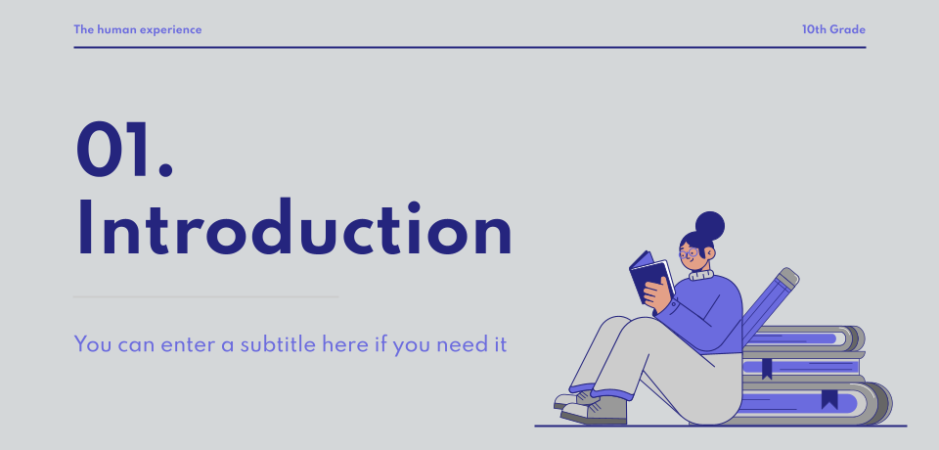
Always learning online
Earth
It’s the third planet from the Sun and the only one that harbors life in the Solar System

Slide 29


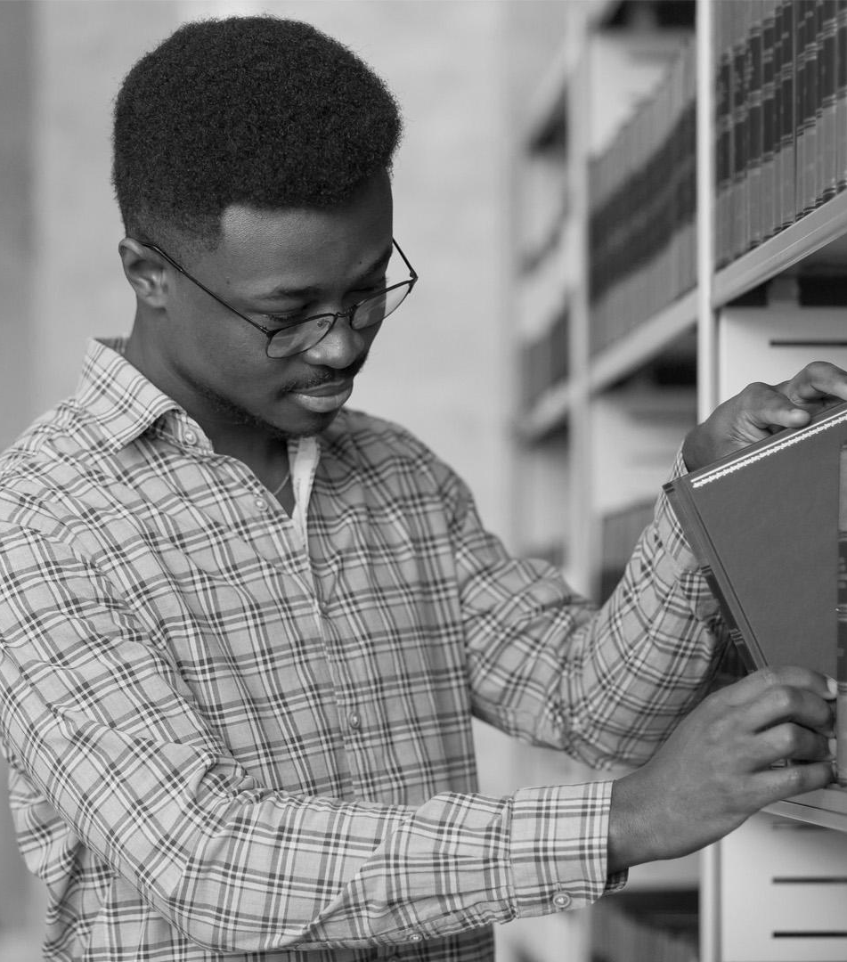
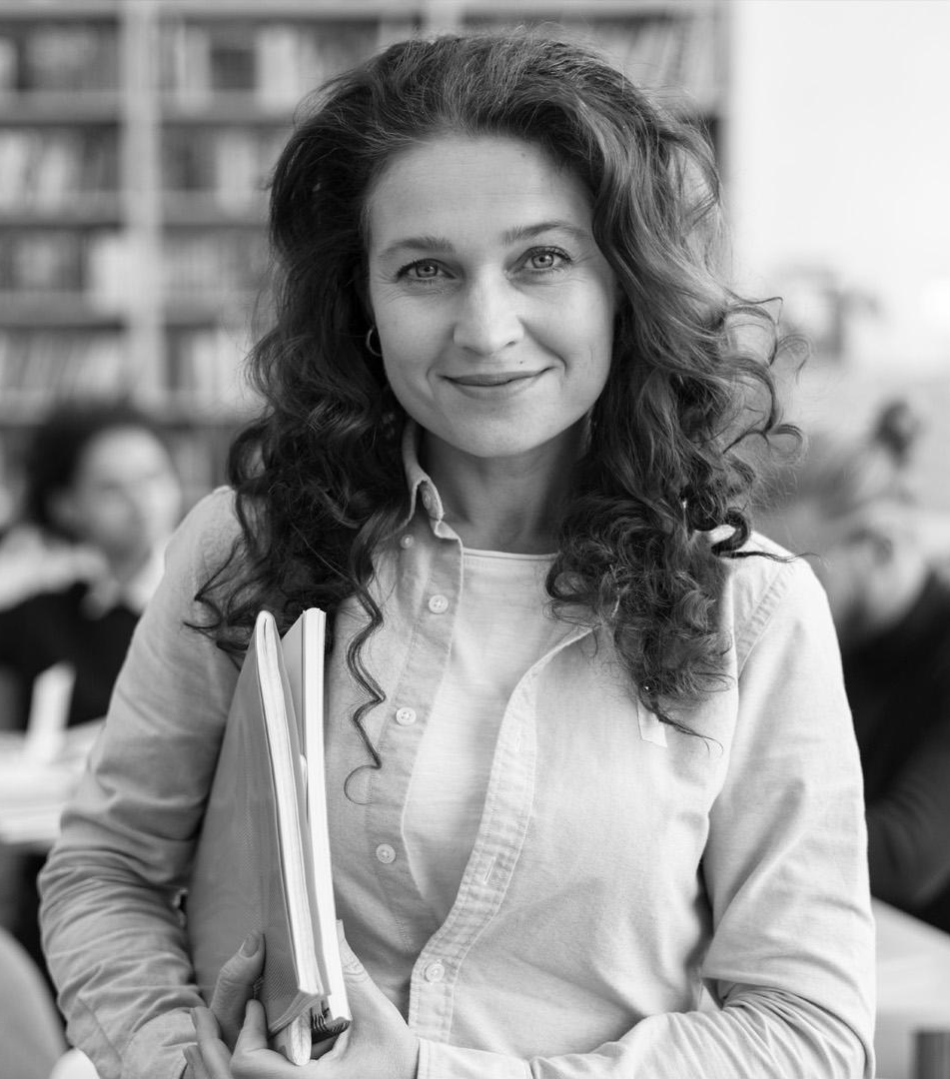
Our literary team
Jenna Doe
John Bones
Timmy Jimmy
Anna Smith
You can speak about this person here
You can speak about this person here
You can speak about this person here
You can speak about this person here

Slide 30
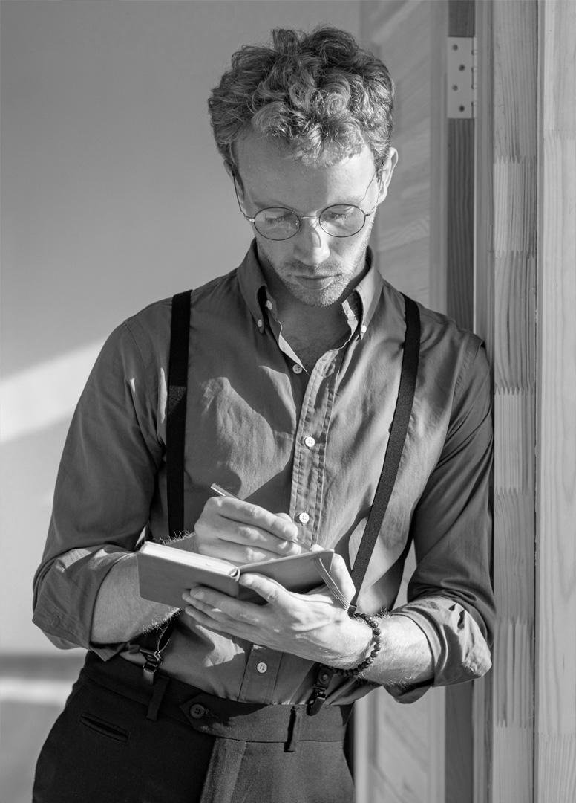
Main conclusions
01.
Neptune
02.
Saturn
03.
Earth
It's the fourth-largest planet by diameter in the Solar System
It was named after the Roman god of wealth and agriculture
Earth is the only planet that harbors life in the Solar System

Slide 31

More information on this website
You can replace the image on the screen with your own work. Just right-click on it and select “Replace image”

Slide 32
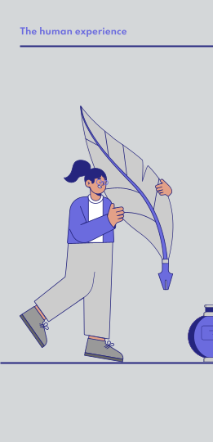
The info you need in this mobile app
You can replace the image on the screen with your own work. Just right-click on it and select “Replace image”

Slide 33
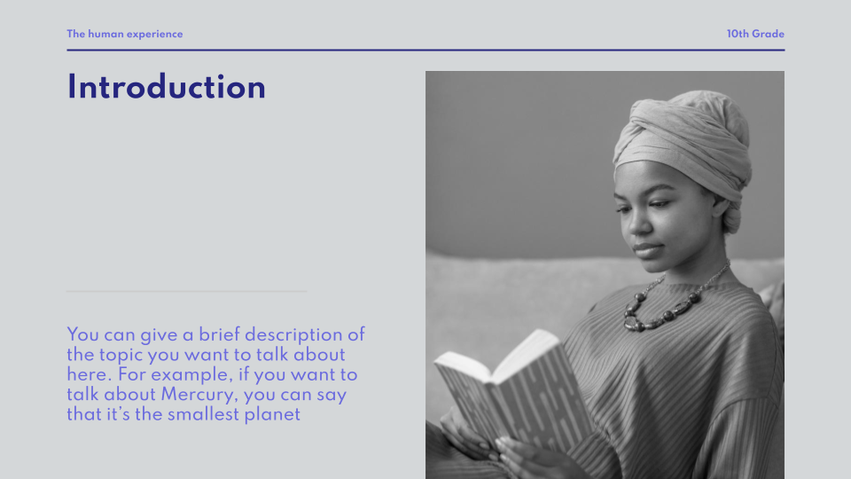
All information in the app
You can replace the image on the screen with your own work. Just right-click on it and select “Replace image”

Slide 34
Thanks!
The human experience
10th grade
Please keep this slide for attribution

Slide 35
Alternative resources

