Slide 1
INTRODUCING MYSELF
Here is where your presentation begins

Slide 2
TABLE OF CONTENTS
01
02
03
04
MERCURY
VENUS
MARS
JUPITER
Here you could describe the topic of the section
Here you could describe the topic of the section
Here you could describe the topic of the section
Here you could describe the topic of the section

Slide 3
WHOA!
This could be the part of the presentation where you can introduce yourself, write your email...

Slide 4
—SOMEONE FAMOUS
“This is a quote, words full of wisdom that someone important said and can make the reader get inspired.”

Slide 5
01
MY COMPANY
You can enter a subtitle here if you need it

Slide 6
THE SLIDE TITLE GOES RIGHT HERE!
Do you know what helps you make your point clear? Lists like this one:
They’re simple
You can organize your ideas clearly
You’ll never forget to buy milk!
And the most important thing: the audience won’t miss the point of your presentation

Slide 7
WHAT SETS US APART?
MERCURY
VENUS
Mercury is the closest planet to the Sun and the smallest one in the Solar System
Venus has a beautiful name and is the second planet from the Sun. It’s terribly hot

Slide 8
OUR OBJECTIVES
JUPITER
It’s a gas giant and the biggest planet in the Solar System
MARS
SATURN
Despite being red, Mars is actually a cold place. It’s full of iron oxide dust
Saturn is a gas giant, composed mostly of hydrogen and helium

Slide 9
ABOUT ME
02
Enter a subtitle here if you need it

Slide 10
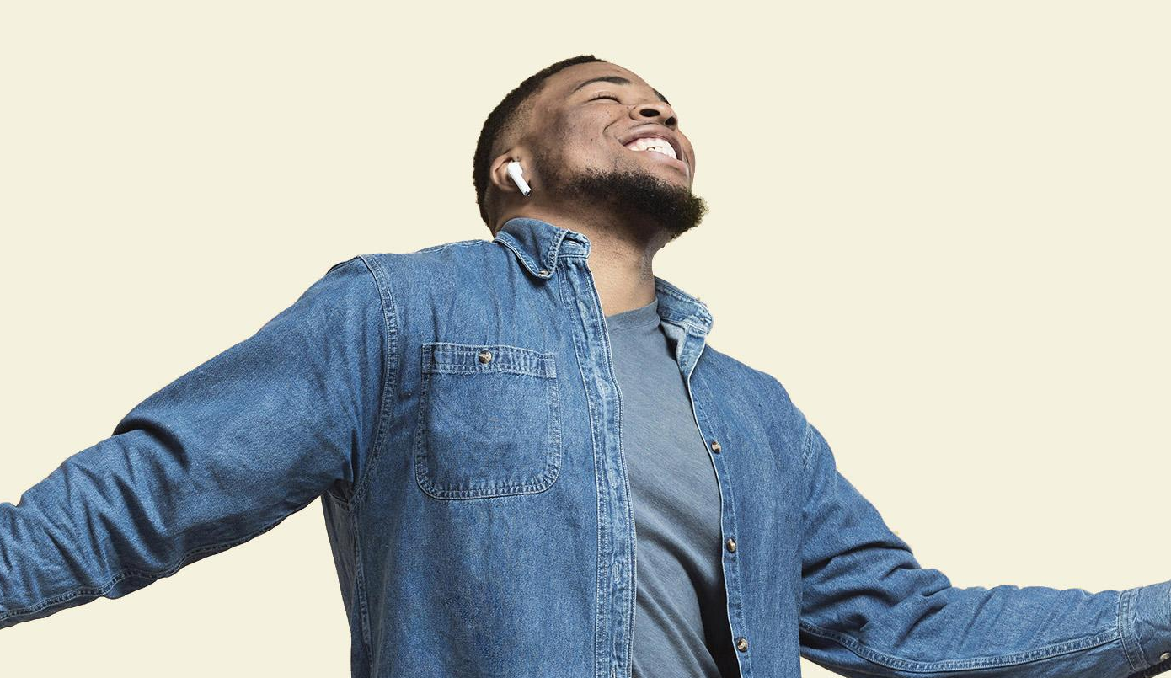
A PICTURE ALWAYS REINFORCES THE CONCEPT

Slide 11
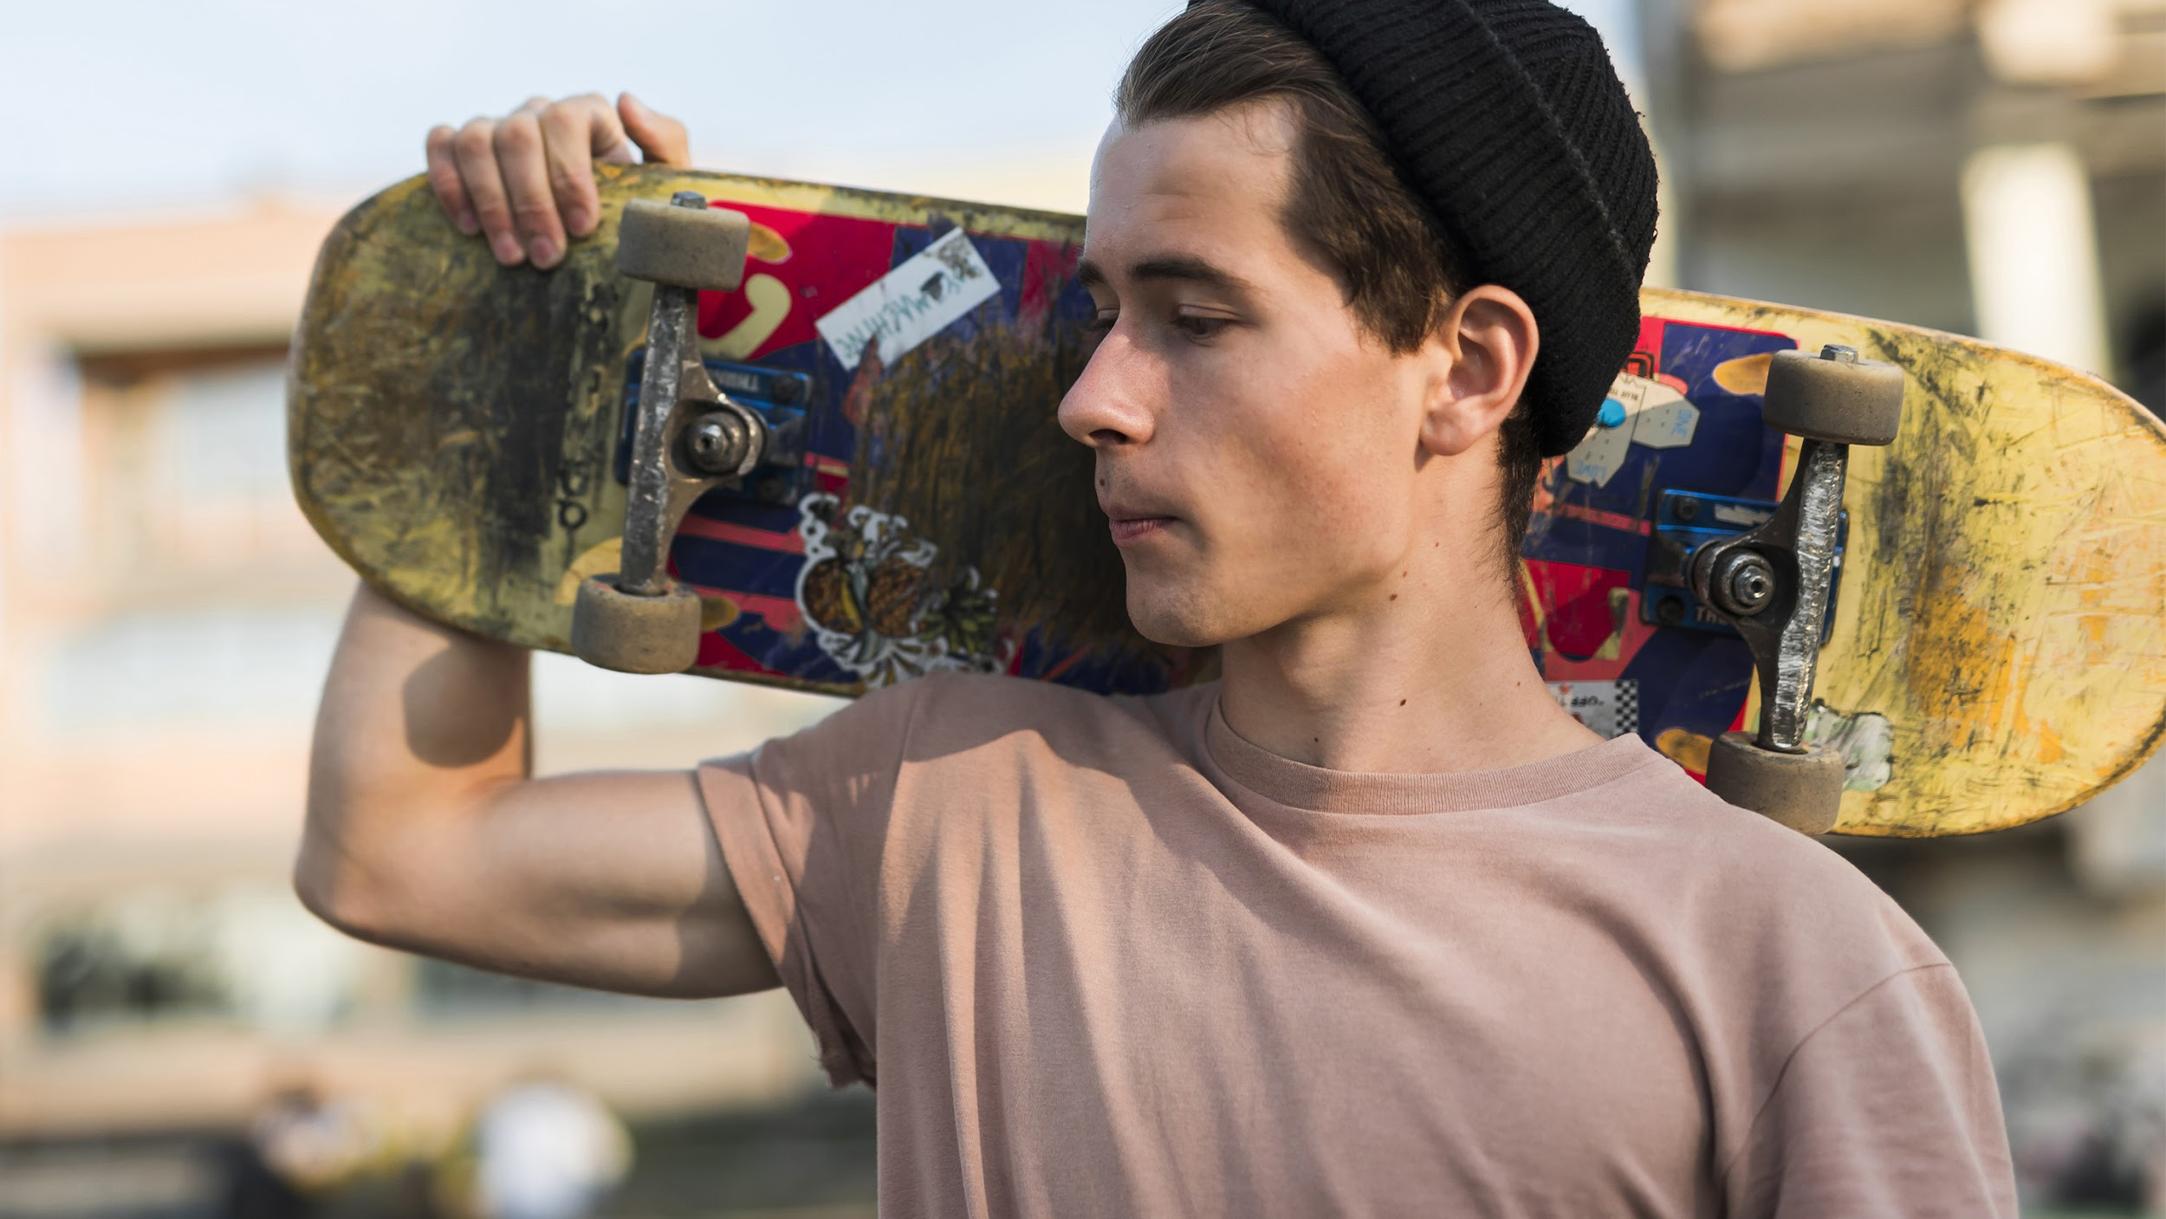
A PICTURE IS WORTH A
THOUSAND WORDS

Slide 12
AWESOME WORDS

Slide 13



MY TEAM
JOHN
JENNA
JAMES
You can replace the image on the screen with your own
You can replace the image on the screen with your own
You can replace the image on the screen with your own

Slide 14

MY STRENGTHS
MARS
Despite being red, it’s a cold place
It’s full of iron oxide dust
It’s the fourth planet from the Sun
It was named after a Roman god

Slide 15
PROMOTION
MULTIMEDIA
PRESS
MOBILE APP
It’s the biggest planet in the Solar System
Saturn is the ringed one and a gas giant
Despite being red, Mars is a cold place

Slide 16
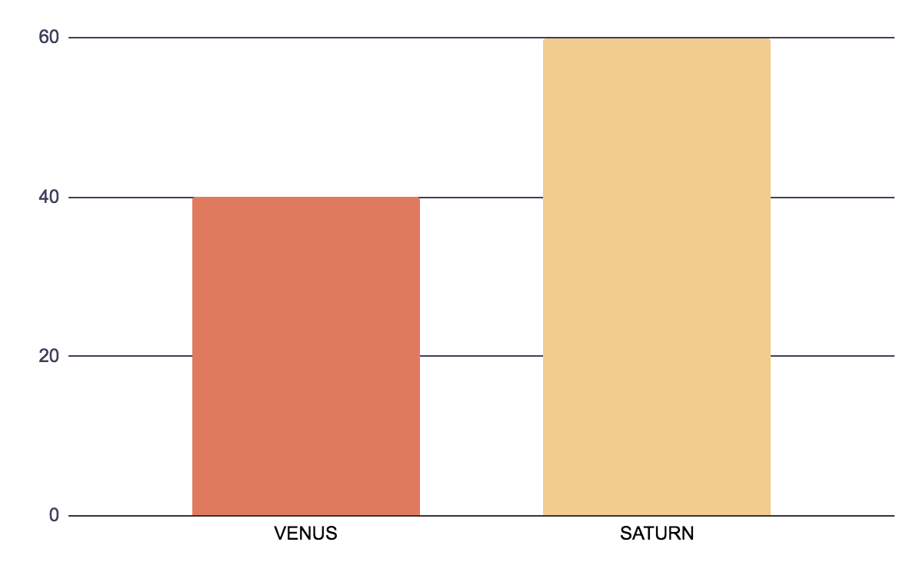
WORK PERFORMANCE
MARS
Despite being red, Mars is actually a cold place
SATURN
40%
60%
Saturn is composed mostly of hydrogen and helium

Slide 17
WHAT I'VE ACHIEVED
MERCURY
VENUS
MARS
Mercury is the closest planet to the Sun
Venus is the second planet from the Sun
Despite being red, Mars is a cold place
JUPITER
SATURN
NEPTUNE
It’s the biggest planet in the Solar System
Saturn is the ringed one and a gas giant
It’s the farthest planet
from the Sun

Slide 18

MY VALUES
LOYALTY
EFFICIENCY
COMMITMENT
Neptune is the farthest planet from the Sun
Venus is the second planet from the Sun
Jupiter is the biggest planet of them all

Slide 19
PERSONALITY
SATURN
VENUS
MARS
MERCURY
Saturn is the ringed one and a gas giant
Venus is the second planet from the Sun
Despite being red, Mars is actually a cold place
Mercury is the closest planet to the Sun

Slide 20
GOALS
SATURN
NEPTUNE
JUPITER
Saturn is the ringed one and a gas giant
It’s the farthest planet
from the Sun
It’s the biggest planet in the Solar System

Slide 21
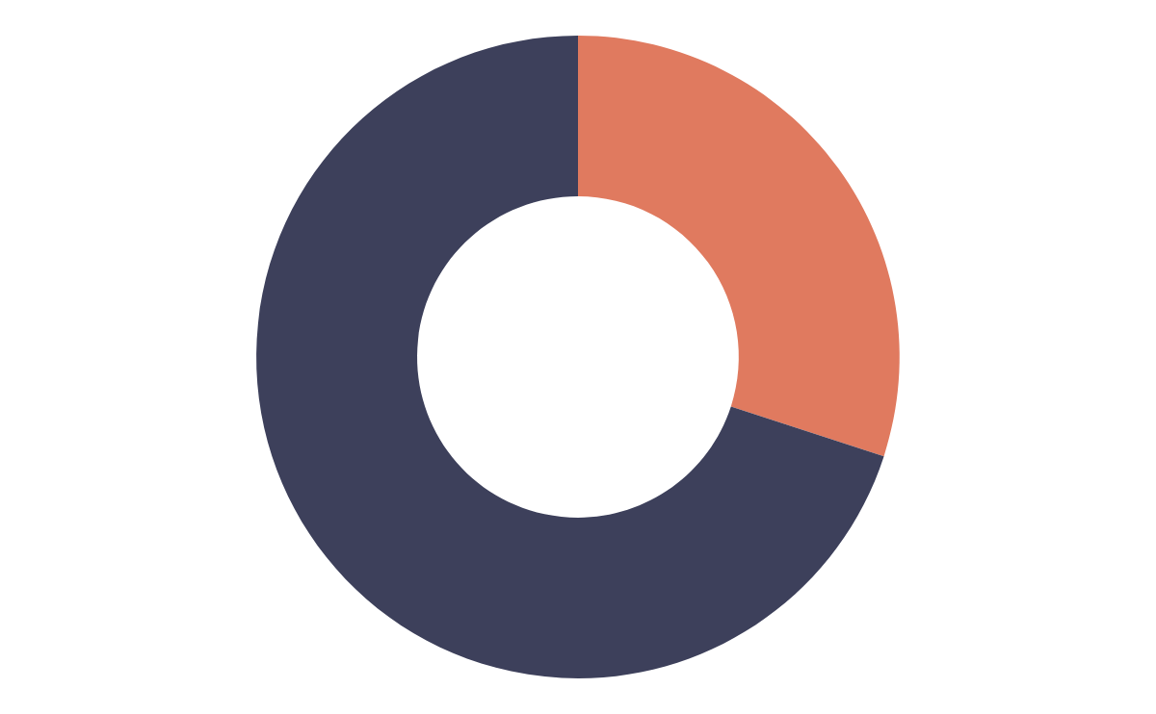
SPOKEN LANGUAGES
70%
30%
MERCURY
JUPITER
Mercury is the closest planet to the Sun
It’s the biggest planet in the Solar System

Slide 22
MY EXPERIENCE
COMPANY 1
COMPANY 2
COMPANY 3
COMPANY 4
Despite being red, Mars is actually a cold place
It was named after the Roman
messenger god
It’s composed mostly of hydrogen and helium
Neptune is the fourth-largest planet of them all

Slide 23
ABOUT MY SKILLS
90%
70%
LEADERSHIP
COMMUNICATION
Despite being red, Mars is actually a cold place
Saturn is composed of hydrogen and helium

Slide 24
MY TABLE
 | MASS | DIAMETER | SURFACE
MERCURY | 0.06 | 0.38 | 0.38
MARS | 0.11 | 0.53 | 0.38
SATURN | 0.06 | 0.11 | 95.2

Slide 25
REFERENCES
VENUS
MARS
JUPITER
It’s the second planet from the Sun
Despite being red, Mars is a cold place
It’s the biggest planet in the Solar System
SATURN
NEPTUNE
Saturn is the ringed one and a gas giant
It’s the farthest planet
from the Sun

Slide 26
WHERE I´VE BEEN
AMERICA
It’s the closest planet to the Sun
EUROPE
Saturn is composed mostly of hydrogen and helium

Slide 27
4,498,300,000
Big numbers catch your audience’s attention

Slide 28
24h
333,000.00
386 km
rotation period
earths is the Sun’s mass
Distance between Earth and the Moon

Slide 29

INTO THE MEDIA
Mercury is the closest planet to the Sun and the smallest one

Slide 30

DESKTOP SOFTWARE
You can replace the image on the screen with your own work. Just delete this one, add yours and center it properly

Slide 31
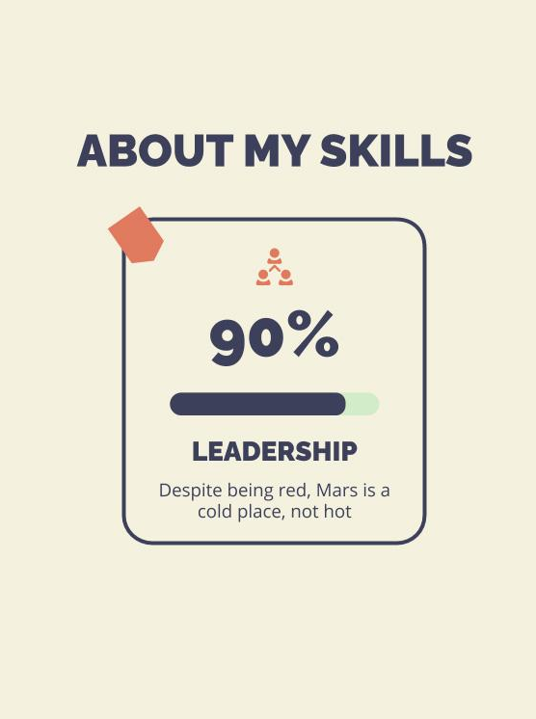
TABLET APP
You can replace the image on the screen with your own work. Just delete this one, add yours and center it properly

Slide 32
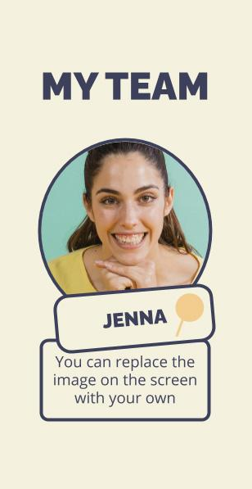
MOBILE WEB
You can replace the image on the screen with your own work. Just delete this one, add yours and center it properly

Slide 33
MY NEW TARGETS
01
02
MERCURY
Mercury is the closest planet to the Sun and the smallest one in the Solar System
VENUS
Venus has a beautiful name and is the second
planet from the Sun. It’s terribly hot

Slide 34
THANKS!

