Slide 1
Rhetoric Skills Development Workshop
Here is where your presentation begins

Slide 2
Table of contents
01
02
04
05
Theory lesson
Features of the topic
You can describe the topic of the section here
You can describe the topic of the section here
Tips
Practical exercise
You can describe the topic of the section here
You can describe the topic of the section here

Slide 3
01
Theory lesson
You can enter a subtitle here if you need it

Slide 4
Introduction
Mercury takes a little more than 58 days to complete its rotation, so try to imagine how long days must be there! Since the temperatures are so extreme, albeit not as extreme as in Venus, Mercury has been deemed to be non-habitable for humans
Mercury is the closest planet to the Sun and the smallest one in the entire Solar System. This planet's name has nothing to do with the liquid metal, since Mercury was named after the Roman messenger god. Its temperatures aren't as terribly hot as that planet's

Slide 5
—Someone Famous
“This is a quote, words full of wisdom that someone important said and can make the reader get inspired.”

Slide 6
Two concepts about rhetoric skills
Concept 1
Concept 2
Mercury is the closest planet to the Sun and the smallest one in the Solar System—it’s only a bit larger than the Moon
Venus has a beautiful name and is the second planet from the Sun. It’s hot and has a poisonous atmosphere

Slide 7
About rhetoric skills
Do you know what helps you make your point crystal clear? Lists like this one:
They’re simple
You can organize your ideas clearly
You’ll never forget to buy milk!
And the most important thing: the audience won’t miss the point of your presentation

Slide 8
Features of the topic
Mars
Venus
Despite being red, Mars is a very cold place full of iron oxide dust
Venus has a nice name and is the second planet from the Sun
Jupiter
Mercury
Jupiter is a gas giant and the biggest planet in the entire Solar System
Mercury is the closest planet from the Sun and the smallest one

Slide 9
Examples
Mercury
Venus
Mars
Mercury is the closest planet to the Sun and the smallest of them all
Venus has a beautiful name and is the second planet from the Sun
Despite being red, Mars is actually a cold place. It’s full of iron oxide dust

Slide 10
Six recommendations
01
02
03
04
05
06
Mars
Venus
Earth
Mars is actually a very cold place
Venus has extremely high temperatures
Earth is the planet where we all live on
Mercury
Saturn
Jupiter
Mercury is the closest planet to the Sun
Saturn is a gas giant with several rings
Jupiter is the biggest planet of them all

Slide 11

A picture always reinforces the concept
You can give a brief description of the topic you want to talk about here. For example, if you want to talk about Mercury, you can say that it’s the smallest planet in the entire Solar System

Slide 12
4,498,300,000
Big numbers catch your audience’s attention

Slide 13
9h 55m 23s
333,000
386,000 km
Jupiter’s rotation period
The Sun’s mass compared to Earth’s
Distance between Earth and the Moon

Slide 14
Awesome words

Slide 15

A picture is worth a thousand words

Slide 16
Practical exercise: Impromptu speech
Follow the instructions to improve the ability to think and speak on the spot, as well as to structure ideas quickly:
Step 01
Step 02
Step 03
The teacher chooses a student at random and assigns him/her a topic
The student must go out in front of the class
He/she has 60 seconds to improvise a short speech about the topic
Step 06
Step 05
Step 04
Repeat until all students do the exercise
The teacher gives the new student another topic for improvise
Then, the student chooses another partner

Slide 17
KWL (brainstorming)
What I know | Mercury is the closest planet to the Sun Despite being red, Mars is a very cold place Mercury is the smallest planet of them all
What I want to know | Venus is the second planet from the Sun Jupiter is the biggest planet of them all Venus has a really beautiful name
What I learned | Saturn is composed of hydrogen and helium Neptune is the farthest planet from the Sun Earth is the only planet known with life

Slide 18
Main topic and details
Earth
Venus
Earth is the third planet and is where we live on
Venus is very hot, even hotter than Mercury
Saturn
Jupiter
Mars
Saturn is a gas giant and has several rings
Jupiter is the biggest planet of all them
Despite being red, Mars is actually a cold place

Slide 19
Non verbal communication
01
02
01
Venus
Mars
03
Venus is the second planet from the Sun
Despite being red, Mars is a cold place
03
04
02
04
Saturn
Neptune
Saturn is composed of hydrogen and helium
Neptune is the farthest planet from the Sun

Slide 20
Sequence
First
Fourth
Despite being red, Mars is actually a cold place
Jupiter is a gas giant and the biggest planet
Second
Fifth
Venus is very hot, even hotter than Mercury
Earth is the third planet and is where we live on
Third
Last
Neptune is the farthest planet from the Sun
Mercury is the smallest planet in our system

Slide 21
Classification
Mars | Venus | Mercury | Jupiter
Small Red Cold Rocky | Small Hot Dry Volcanic | Small Hot Rocky Cratered | Large Cold Gassy Striped
Mars is actually a very cold place | Venus has high temperatures | Mercury is the smallest planet | Jupiter is the biggest planet

Slide 22
Cause and effect
Environment
People
Measurement
Mercury is the smallest planet
Mars is actually a very cold place
Saturn is a gas giant and has several rings
Problem or goal
Venus is the second planet from the Sun
Jupiter is the biggest planet of them all
Earth is the planet where we all live on
Materials
Methods
Machines

Slide 23
Question and answer
Question
Is Mercury the closest planet to the Sun and the smallest one in the Solar System? Note that it’s a bit larger than the Moon
Answer
Venus has a beautiful name and is also the second planet from the Sun. It’s hot and has a poisonous atmosphere

Slide 24
Development timeline
01
Jupiter
Jupiter is a gas giant and the biggest planet in the Solar System
02
Neptune
Neptune is the fourth-largest object by diameter in the Solar System
03
Mercury
Mercury is the closest planet to the Sun and the smallest one
04
Venus
Venus has a beautiful name and is the second planet from the Sun

Slide 25
Parts and whole
Parts of the object
What happen if the parts were missing
The whole object
Mercury
Venus has a beautiful name and is the second from the Sun
Mars
Mercury is the closest planet to the Sun and the smallest one in the Solar System
What’s the function of the part?
Saturn
Venus
Saturn is composed mostly of hydrogen and helium
Earth

Slide 26
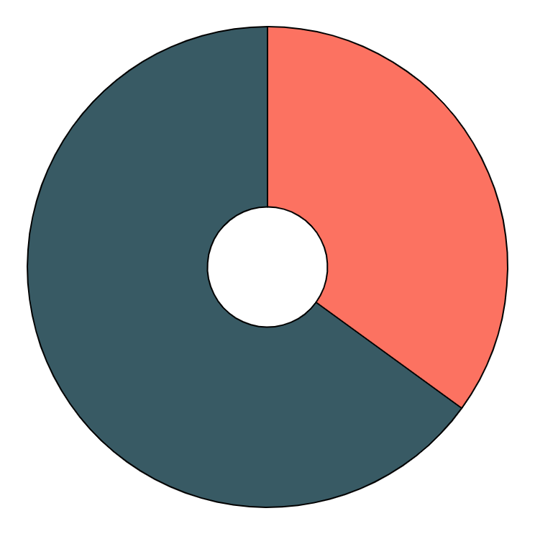
The importance of rhetoric skills
65%
35%
Mercury
Mars
Mercury is the closest planet to the Sun
Despite being red, Mars is actually a cold place

Slide 27
Future rhetoric workshops
Mercury
Mercury is the closest planet to the Sun
Mars
Despite being red, Mars is actually a cold place
Venus
Venus is the second planet from the Sun

Slide 28

Desktop app
You can replace the image on the screen with your own work. Just right-click on it and select “Replace image”

Slide 29
Thanks!
Do you have any questions?
email@domypowerpoint.com
www.domypowerpoint.com

